Slide 1
6 options for LAI calculation
All six plots are for the same soy point

Slide 2
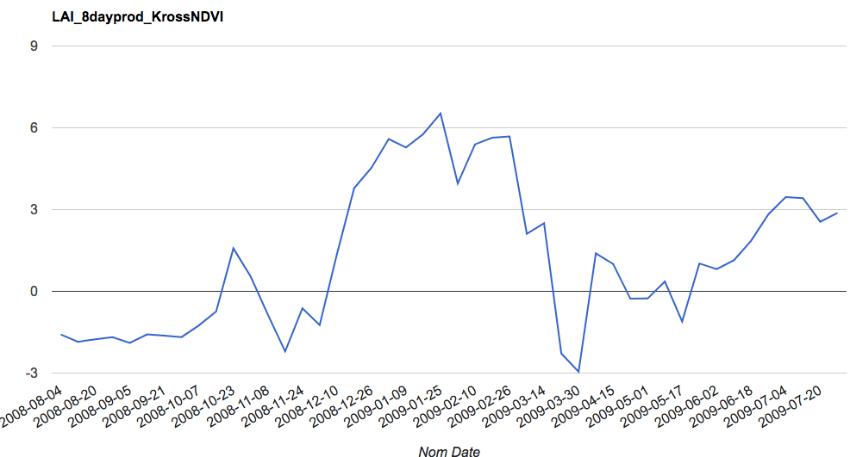
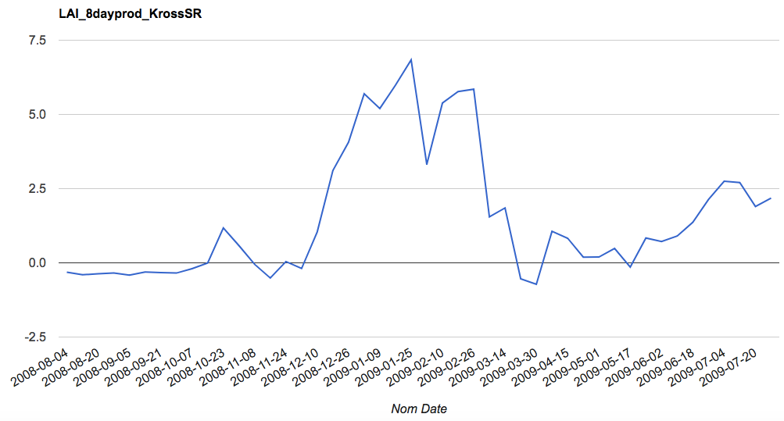
MODIS product: 8-day composite, MYD09A1
LAI eqn: “Kross NDVI”
The x-axis for all six plots is nominal date (evenly spaced), but the csv files that I’ll send you will have actual acquisition dates in DOY.
MODIS product: 8-day composite, MYD09A1
LAI eqn: “Kross SR”
I will do some more cloud filtering for the 8-day composites, that should make the data less noisy – but I suspect it will then look at lot like the 16-day composite. So it would be the same temporal resolution as Landsat, but a worse spatial resolution than Landsat…

Slide 3
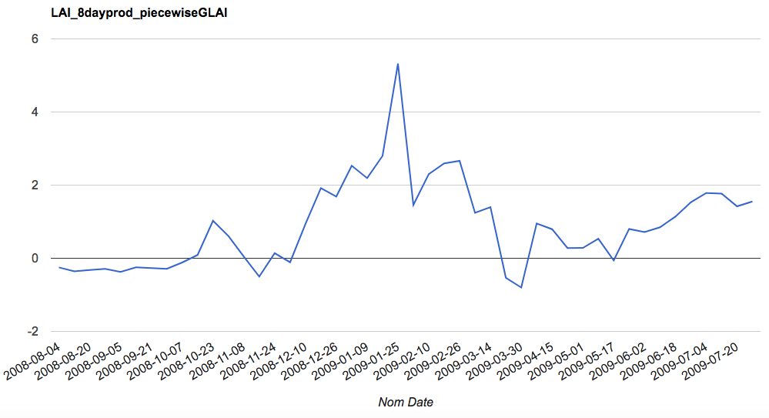
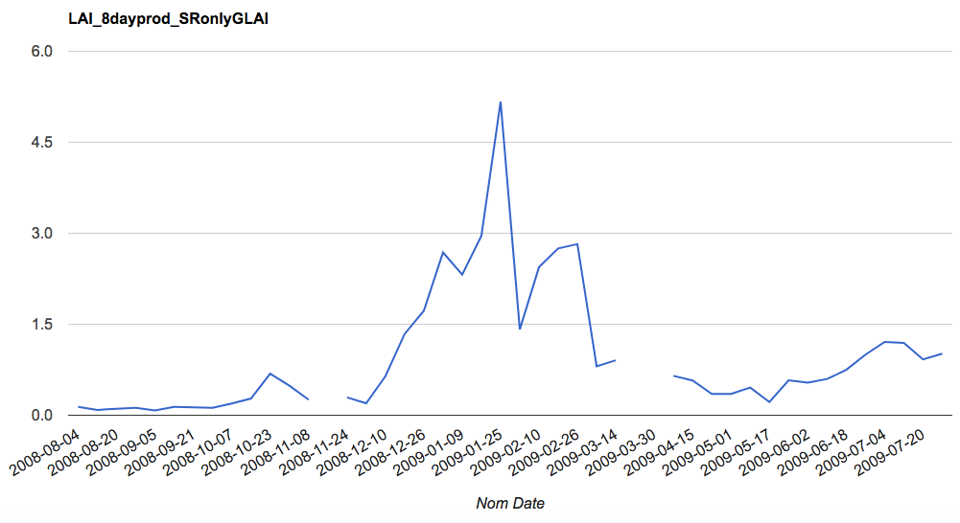
MODIS product:8-day composite, MYD09A1
gLAI eqn: “piecewise”
These two plots are of gLAI, but I’m including them to compare to the MODIS LAI product on the next slide
MODIS product: 8-day composite, MYD09A1
gLAI eqn: “SR only”

Slide 4
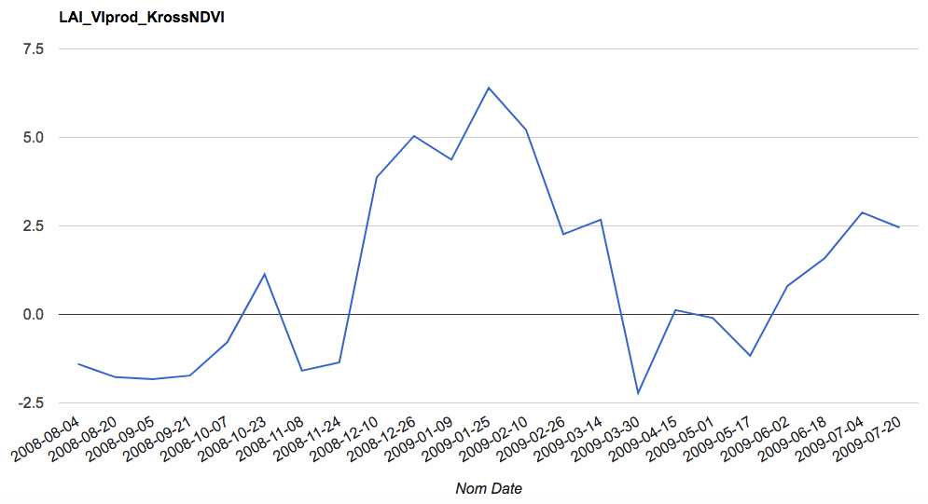
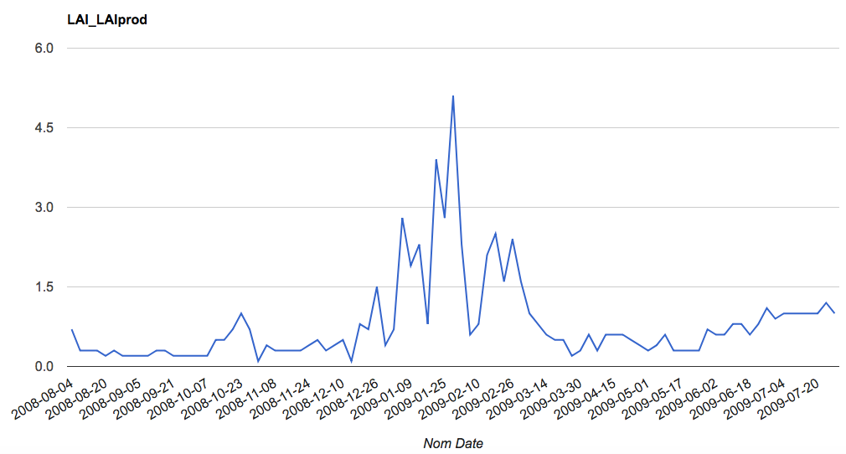
MODIS product: Veg Indices, 16 day composite, MYD13Q1
LAI eqn: “Kross NDVI”
This was calculated using the NDVI band. I can find another LAI equation to use this product’s EVI band. Do you want that?
MODIS product: LAI, 4 day composite, MCD15A3H
The MODIS LAI product looks like gLAI instead of LAI…
It also has a lot more noise than the other composites, probably because 4 days isn’t enough to avoid clouds
Therefore, I’m thinking we won’t use the MODIS LAI product?

